Slide 1
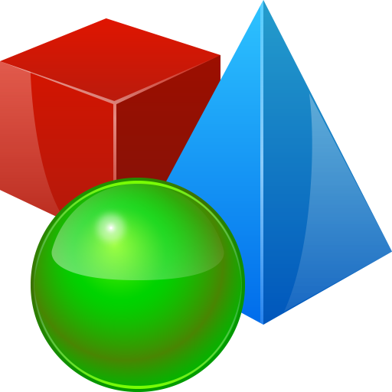
Objects and Classes
Using Objects and Classes Defining Simple Classes
SoftUni Team
Technical Trainers
Software University
https://softuni.bg

Slide 2
Table of Contents
Objects
Classes
Built in Classes
Defining Simple Classes
Properties
Methods
Constructors

Slide 3
Have a Question?
sli.do
#fund-csharp

Slide 4

What is an Object? What is a Class?
Objects and Classes

Slide 5
Classes
In programming, classes provide the structure for objects
Act as templates for objects of the same type
Classes define:
Properties (data), e.g. Name, Age
Behaviours (actions), e.g. Bark()
One class may have many instances (objects)
Sample class: Dog
Sample objects: sparky, rufus

Slide 6
Classes – Example
class Dog
{
public string Name { get; set; }
public string Breed { get; set; }
public int Age { get; set; }
public void Bark()
{
Console.WriteLine("Bark!")
}}
Name
Properties
Method

Slide 7
Objects
An object holds a set of named values
Creating a Dog object:
Create a new object of type Dog
Dog
Name = "Sparky" Breed = "Corgi" Age = 3
Object name
var puppy = new Dog ("Sparky", "Corgi", 3); Console.WriteLine(puppy);
Object properties
The new operator creates a new object
var puppy = new Dog {Name = "Sparky", Breed = "Corgi", Age = 3 };

Slide 8
Objects – Instances of Classes
Creating the object of a defined class is called instantiation
The instance is the object itself, which is created runtime
All instances have common behaviour
Dod sparky = new Dog("Sparky", "Corgi", 5);
Dog rufus = new Dog("Rufus", "Shepherd", 3);
Dog allie = new Dog("Allie", "Husky", 2);

Slide 9
Classes vs Objects
Classes provide structure for creating objects
An object is a single instance of a class
class Dog
object sparky
Object name
Name
Name: string
Breed: string
Age: int
Name = "Sparky"
Breed = "Corgi"
Age = 3
Properties
Object data
Bark(…)
Eat(…)
Methods

Slide 10
Math, Random, BigInteger, ...
Math.Max()
Using the Built-in API Classes

Slide 11
Built-in API Classes in .NET Core
.NET Core provides thousands of ready-to-use classes
Packaged into namespaces like System, System.Text, System.Collections, System.Linq, System.Net, etc.
Using static .NET class members
Using non-static .NET classes
double cosine = Math.Cos(Math.PI);
Random rnd = new Random();
int randomNumber = rnd.Next(1, 99);

Slide 12
Problem: Randomize Words
You are given a list of words
Randomize their order and print each word at a separate line
a b
PHP Java C#
b
a
Java
PHP
C#
Note: The output is a sample. It should always be different!
Check your solution here: https://judge.softuni.org/Contests/Practice/Index/1214#0

Slide 13
Solution: Randomize Words
string[] words = Console.ReadLine().Split(' ');
Random rnd = new Random();
for (int pos1 = 0; pos1 < words.Length; pos1++)
{
int pos2 = rnd.Next(words.Length);
// TODO: Swap words[pos1] with words[pos2]
}
Console.WriteLine(string.Join(Environment.NewLine, words));
Check your solution here: https://judge.softuni.org/Contests/Practice/Index/1214#0

Slide 14
Problem: Big Factorial
Calculate n! (n factorial) for very big n (e.g. 1000)
5
120
10
3628800
12
479001600
30414093201713378043612608166064768844377641568960512000000000000
50
185482642257398439114796845645546284380220968949399346684421580986889562184028199319100141244804501828416633516851200000000000000000000
88
Check your solution here: https://judge.softuni.org/Contests/Practice/Index/1214#1

Slide 15
Solution: Big Factorial
Use the .NET API class System.Numerics .BigInteger
using System.Numerics;
...
int n = int.Parse(Console.ReadLine());
BigInteger f = 1;
for (int i = 2; i <= n; i++)
f *= i;
Console.WriteLine(f);
N!
Check your solution here: https://judge.softuni.org/Contests/Practice/Index/1214#1

Slide 16

Creating Custom Classes
Defining Classes

Slide 17
Defining Simple Classes
Specification of a given type of objects from the real-world
Classes provide structure for describing and creating objects
Class name
Keyword
class Dice
{
…
}
Class body

Slide 18


Naming Classes
Use PascalCase naming
Use descriptive nouns
Avoid abbreviations (except widely known, e.g. URL, HTTP, etc.)
class Dice { … }
class BankAccount { … }
class IntegerCalculator { … }
class TPMF { … }
class bankaccount { … }
class intcalc { … }

Slide 19
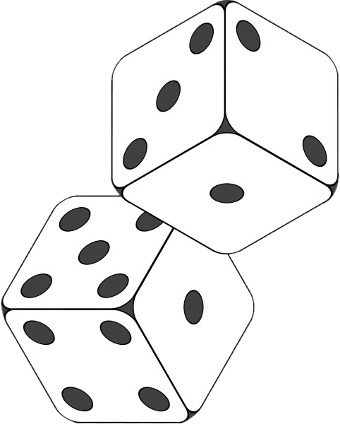
Class Members
Class is made up of state and behaviour
Properties store state
Methods describe behaviour
class Dice
{
public int Sides { get; set; }
public string Type { get; set; }
public void Roll() { }
}
Properties
Method

Slide 20

Creating an Object
A class can have many instances (objects)
class Program
{
public static void Main()
{
Dice diceD6 = new Dice();
Dice diceD8 = new Dice();
}
}
Use the new keyword

Slide 21
Properties
Describe the characteristics of a given class
class Student
{
public string FirstName { get; set; }
public string LastName { get; set; }
public int Age { get; set; }
}
The getter provides access to the field
The setter provides field change

Slide 22
Methods
Store executable code (algorithm)
class Dice
{
public int Sides { get; set; }
public int Roll()
{
Random rnd = new Random();
return rnd.Next(1, Sides + 1);
}
}

Slide 23

Constructors
Special methods, executed during object creation
class Dice
{
public int Sides { get; set; }
public Dice()
{
this.Sides = 6;
}
}
Constructor name is the same as the name of the class
Overloading default constructor

Slide 24
Constructors (2)
You can have multiple constructors in the same class
class Dice
{
public Dice() { }
public Dice(int sides)
{
this.Sides = sides;
}
p int Sides { get; set; }
}
class StartUp
{
public static void Main()
{
Dice dice1 = new Dice();
Dice dice2 = new Dice(7);
}
}

Slide 25
Class Operations
Classes can define data (state) and operations (actions)
class Rectangle
{
public int Top { get; set; }
public int Left { get; set; }
public int Width { get; set; }
public int Height { get; set; }
int CalcArea()
{
return Width * Height;
}
Classes may hold data (properties)
Classes may hold operations (methods)

Slide 26
Class Operations (2)
public int Bottom
{
get
{
return Top + Height;
}
}
public int Right
{
get
{
return Left + Width;
}
}
Calculated property
Calculated property
Boolean method
public bool IsInside(Rectangle r)
{
return (r.Left <= Left) && (r.Right >= Right) &&
(r.Top <= Top) && (r.Bottom >= Bottom);
}

Slide 27

Summary
…
…
…
Objects
Holds a set of named values
Instance of a class
Classes define templates for object
Methods
Constructors
Properties

Slide 28
Questions?
Notes:
28

Slide 29












SoftUni Diamond Partners

Slide 30


Educational Partners

Slide 31
Trainings @ Software University (SoftUni)
Software University – High-Quality Education, Profession and Job for Software Developers
softuni.bg, about.softuni.bg
Software University Foundation
softuni.foundation
Software University @ Facebook
facebook.com/SoftwareUniversity
Software University Forums
forum.softuni.bg
Notes:
31

Slide 32

License
This course (slides, examples, demos, exercises, homework, documents, videos and other assets) is copyrighted content
Unauthorized copy, reproduction or use is illegal
© SoftUni – https://about.softuni.bg/
© Software University – https://softuni.bg
Notes:
32

